Slide 1

IBM DATA SCIENCE CERTIFICATION
COURSE 9 FINAL CAPSTONE.
CAR ACCIDENT SEVERITY PREDICTION IN SEATTLE
Author: Julio Ferrón

Slide 2

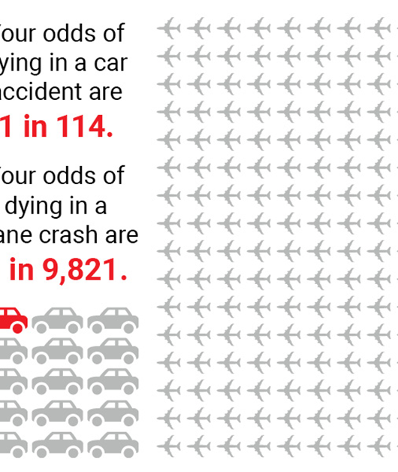
1. Business Problem
The aim of this project is to help stakeholders reduce exposure to the risk of suffer a fatal car accident based on a prediction of the severity of a car accident based on different conditions.

Slide 3
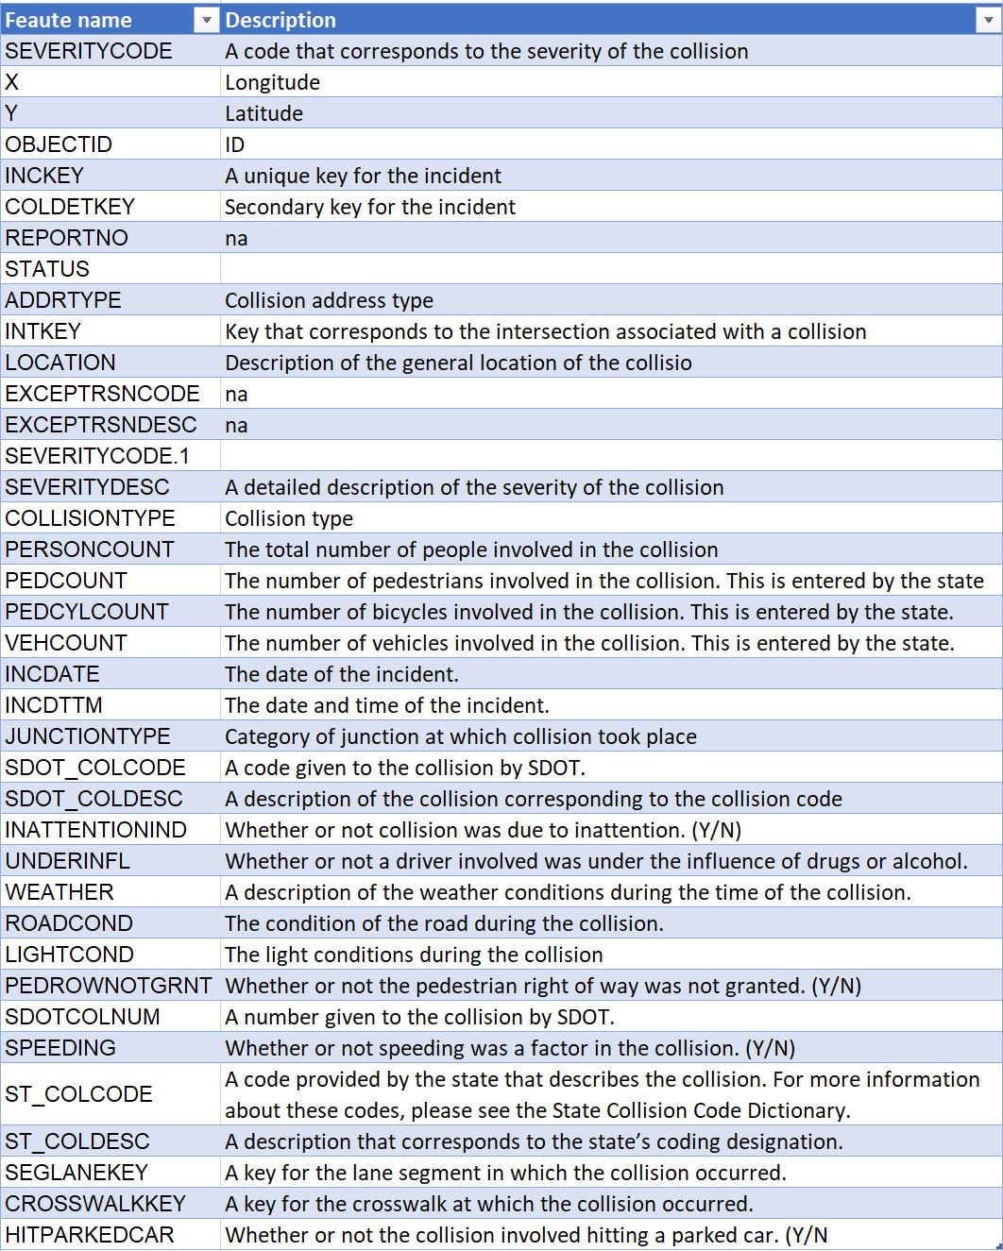
2. Data Understanding and Preparation
We will use for our purpose the following dataset:
"All collisions provided by SPD and recorded by Traffic Records " This Dataset includes a record of all collisions ocurred in the city of Seattle (Washingthon) from 2004 to 2020.
The dataset includes the feature "SEVERITY CODE" which indicates the severity of the car accident. This variable will be our dependent variable (Y), and our goal will be to predict it. The variable can have the following values per accident:
2—injury: physical harm referred to a person
1—prop damage: material damage.

Slide 4

2. Data Understanding and Preparation
In this sense we have:
Selected the more adequate columns based on the metadata info.
Identifyng and replaced missing values.
Encode categorical variables

Slide 5
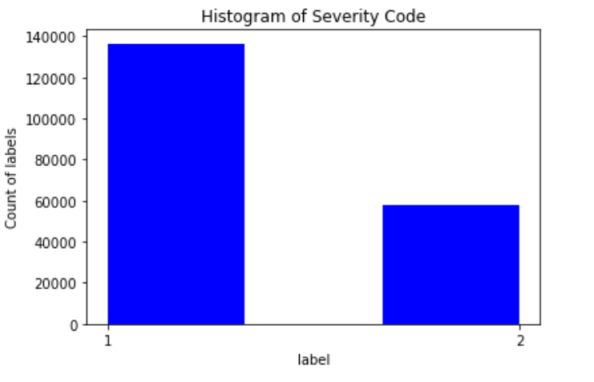
3. Methodology
Exploratory Data Analysis
The value 1 "Property damage" it represented almost the double than the value 2 "injury". That means that the data needs to be balance in order to the model perform correctly. Imbalanced classification involves developing predictive models on classification datasets that have a severe class imbalance.
We used SMOT to solve this issue.

Slide 6
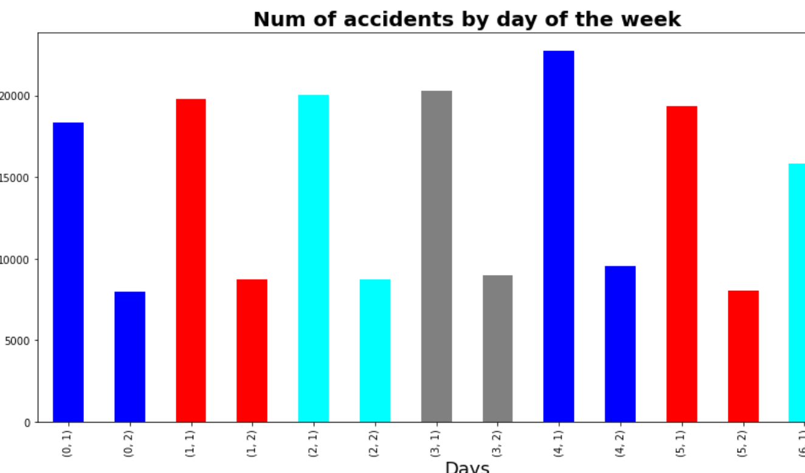
3. Methodology
Exploratory Data Analysis
One hypothesis that could make sense is that the day of the week could be relevant in order to predict the severity of the accident
We have transformed the column ‘INCDATE’ to get the day of the week. It looks like the day of the week does not have much impact on the severity of the accident

Slide 7
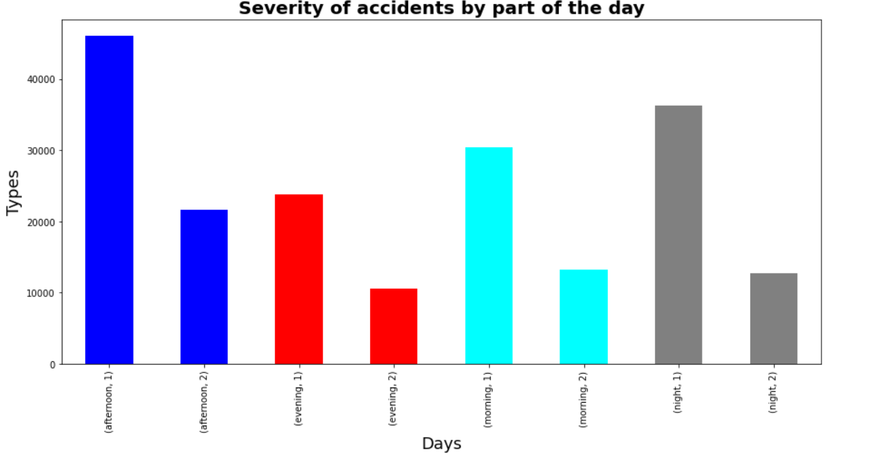
3. Methodology
Exploratory Data Analysis
it is known that the drivers could be affect by the moment of the day in their behavior, for example getting sleepier after certain meals. Let’s repeat the transforming exercise now with ‘INCDTTM'.
We have transformed the column ‘INCDATE’ to get the day of the week. It looks like the day of the week does not have much impact on the severity of the accident

Slide 8
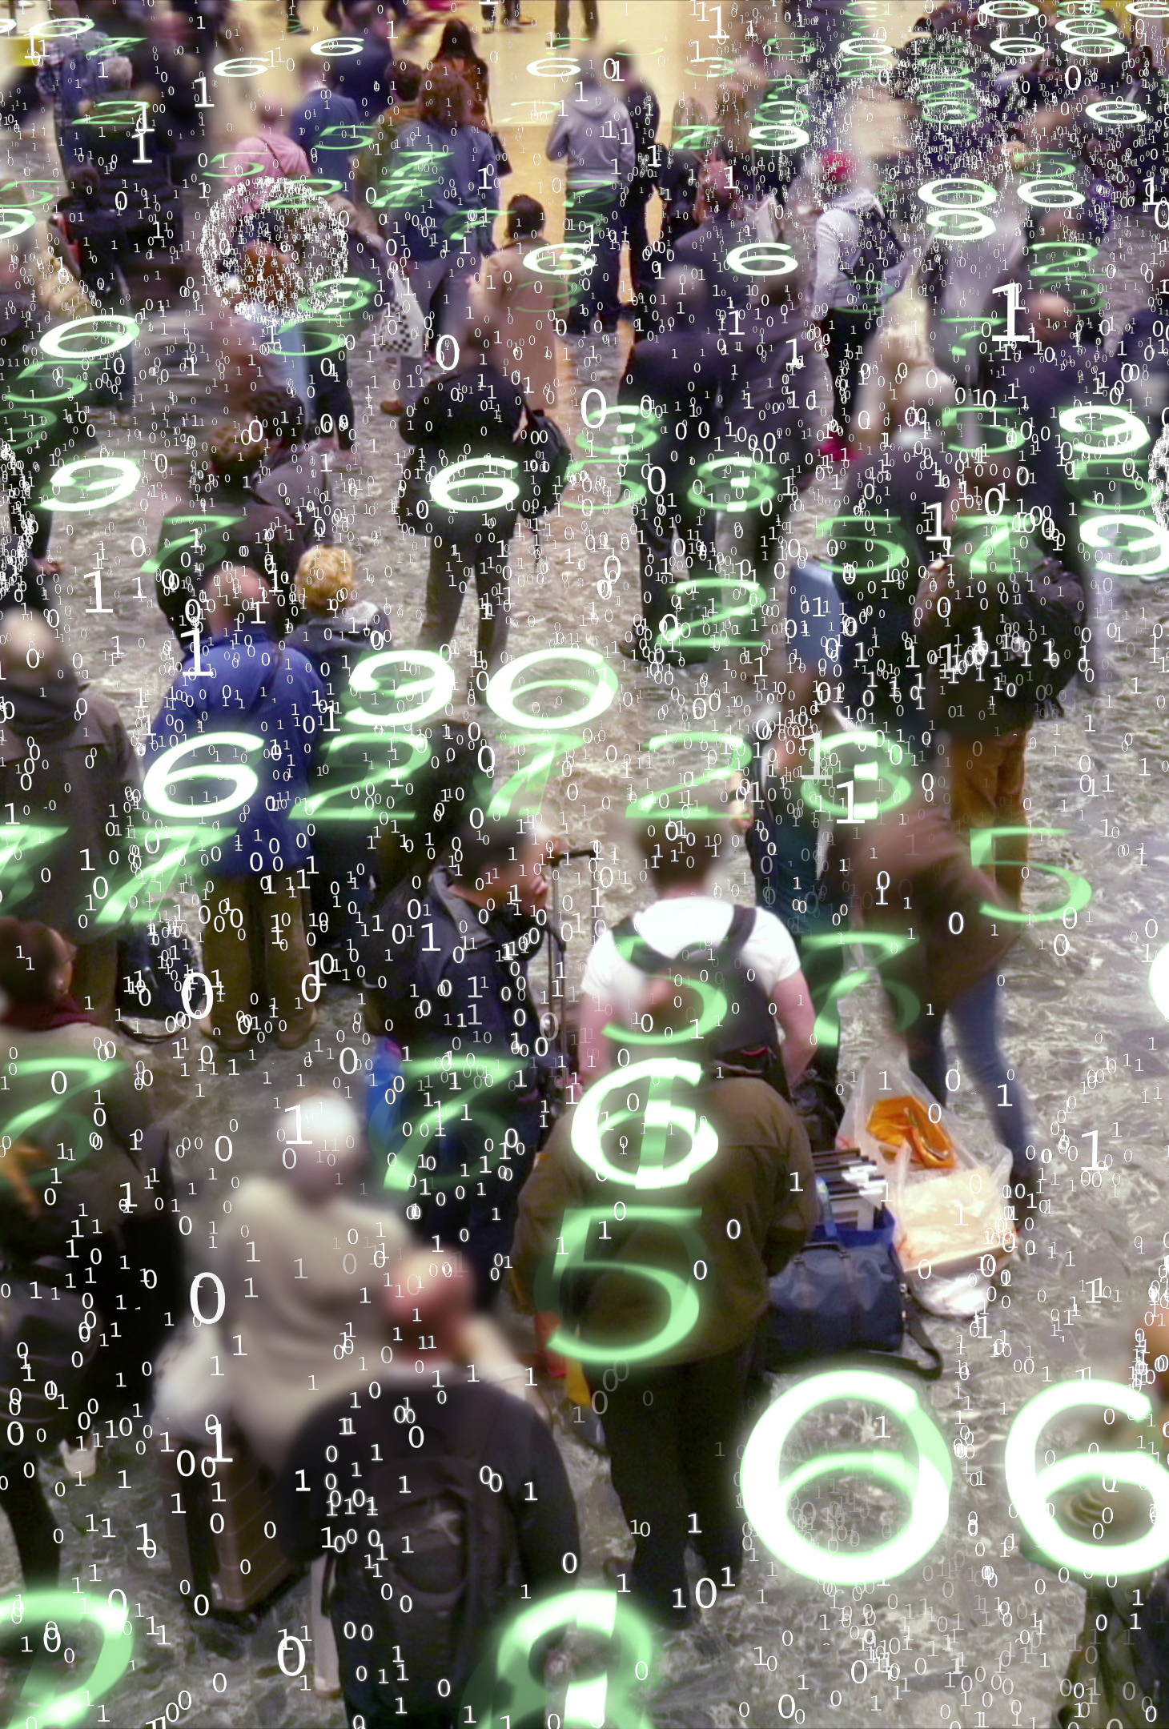
4. Classification
We are going to use the training set to build an accurate model with the help of different classification techniques in order to find the most accurate approach:
Decision Trees.
K-Nearest Neighbor.
Logistic regression.
SVM.

Slide 9
3. Methodology
4. Results
DECISION TREE
K NEAREST
LOGARISTIC REGRESSION
SVM

